Slide 1
Geometry of Stein variational gradient descent (Dunkan,2019)
Nikita Mashalov

Slide 2
Plan
Motivation
Recap on Stein Gradient
Geometry: inequalities on GF with Sobolev and Poincare inequalities
Questions

Slide 3
Motivation
Suppose we have oracle x –> ∇log p(x), suggest method to sample
Schemes like HMC and Langevin suffers from correlation issues between samples
Sample in group and give penalty for correlation -> Stein Gradient Descent (Liu,2015)
Method suffers from curse of dimension. Need convergence guarantee -> Geometry of SGVD (Duncan, 2019)

Slide 4
Setting

Slide 5
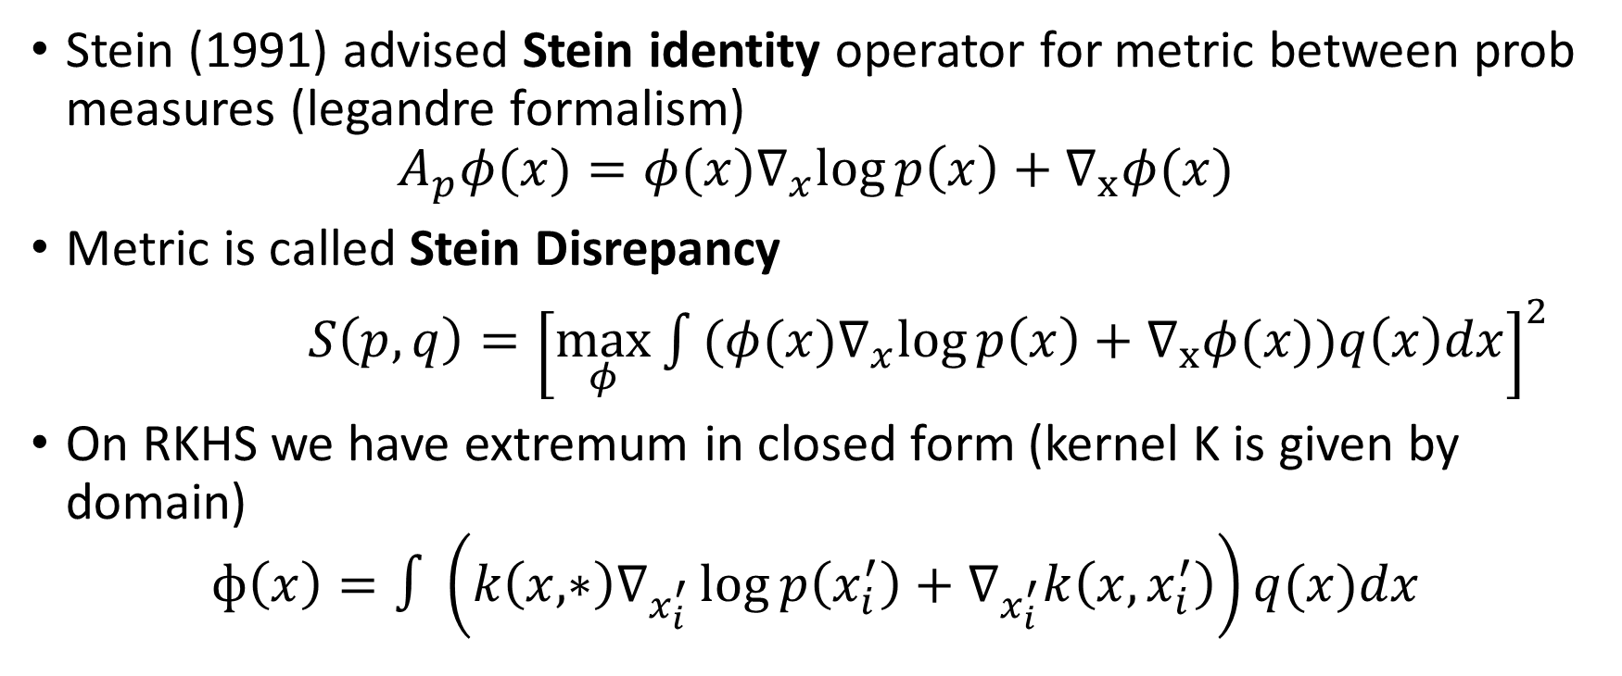
Stein Framework
Stein (1991) advised Stein identity operator for metric between prob measures (legandre formalism)
$$A_{p}φ(x)={φ(x)∇}_{x}log{p\left(x\right)+∇_{x}φ(x)}$$
Metric is called Stein Disrepancy
$S\left(p,q\right)={\left[\max_{φ}{\int{{(φ(x)∇}_{x}log{p\left(x\right)}}+∇_{x}φ(x))q\left(x\right)dx}\right]}^{2}$
On RKHS we have extremum in closed form (kernel K is given by domain)
$$ф\left(x\right)=∫\left(k\left(x, ∗\right)∇_{x_{i}^{′}}\log{p\left(x_{i}^{′}\right)}+∇_{x_{i}^{′}}k\left(x,x_{i}^{′}\right)\right)q(x)dx$$

Slide 6
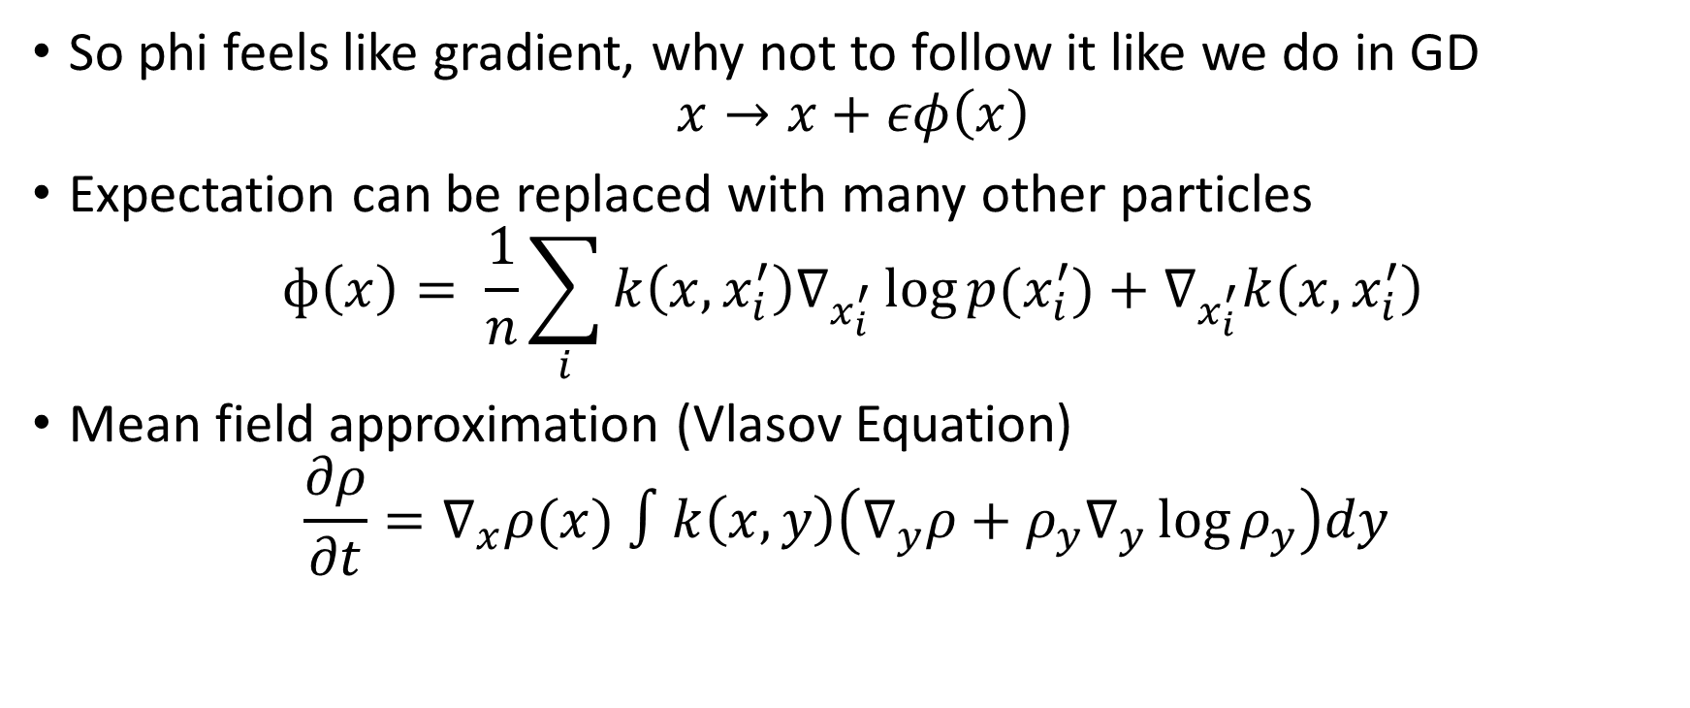
Sampling strategy
So phi feels like gradient, why not to follow it like we do in GD
$$x→x+εφ\left(x\right)$$
Expectation can be replaced with many other particles
$$ф\left(x\right)= \frac{1}{n}\sum_{i}{k\left(x,x_{i}^{′}\right)∇_{x_{i}^{′}}\log{p(x_{i}^{′})}+∇_{x_{i}^{′}}k\left(x,x_{i}^{′}\right)}$$
Mean field approximation (Vlasov Equation)
$$\frac{∂ρ}{∂t}=∇_{x}ρ(x) ∫k\left(x,y\right)\left(∇_{y}ρ+{ρ_{y}∇}_{y}\log{ρ_{y}}\right)dy$$

Slide 7
Convergence of Mean Field

Slide 8
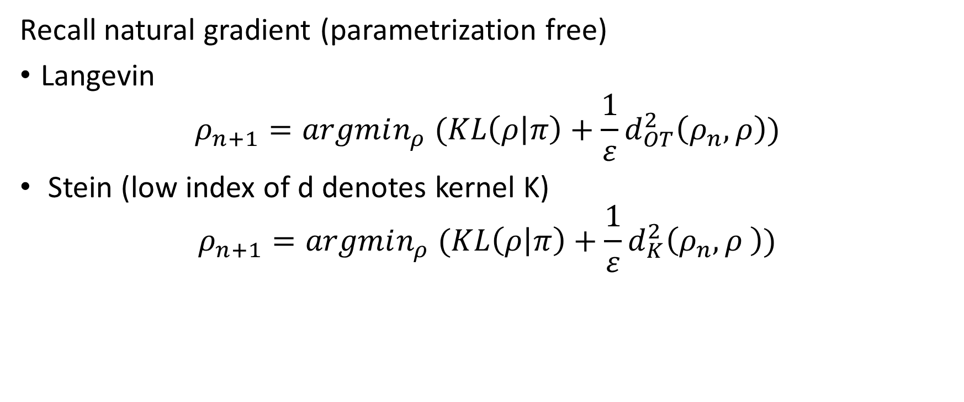
Interrelation between sampling strategies
Recall natural gradient (parametrization free)
Langevin
$$ρ_{n+1}=argmin_{ρ} (KL\left(ρ | π\right)+\frac{1}{ε}d_{OT}^{2}\left(ρ_{n},ρ\right))$$
Stein (low index of d denotes kernel K)
$$ρ_{n+1}=argmin_{ρ} (KL\left(ρ | π\right)+\frac{1}{ε}d_{K}^{2}\left(ρ_{n},ρ \right))$$

Slide 9
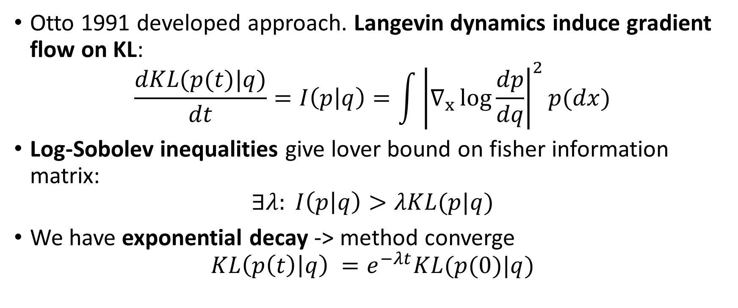
Otto formalism for Langevin dynamics
Otto 1991 developed approach. Langevin dynamics induce gradient flow on KL:
$$\frac{dKL(p(t)|q)}{dt}=I\left(p | q\right)=\int{{\left|∇_{x}\log{\frac{dp}{dq}}\right|}^{2}p(dx)}$$
Log-Sobolev inequalities give lover bound on fisher information matrix:
$$∃λ: I\left(p | q\right)>λKL(p|q)$$
We have exponential decay -> method converge
$$KL\left(p\left(t\right) | q\right) =e^{−λt}KL(p(0)|q)$$

Slide 10
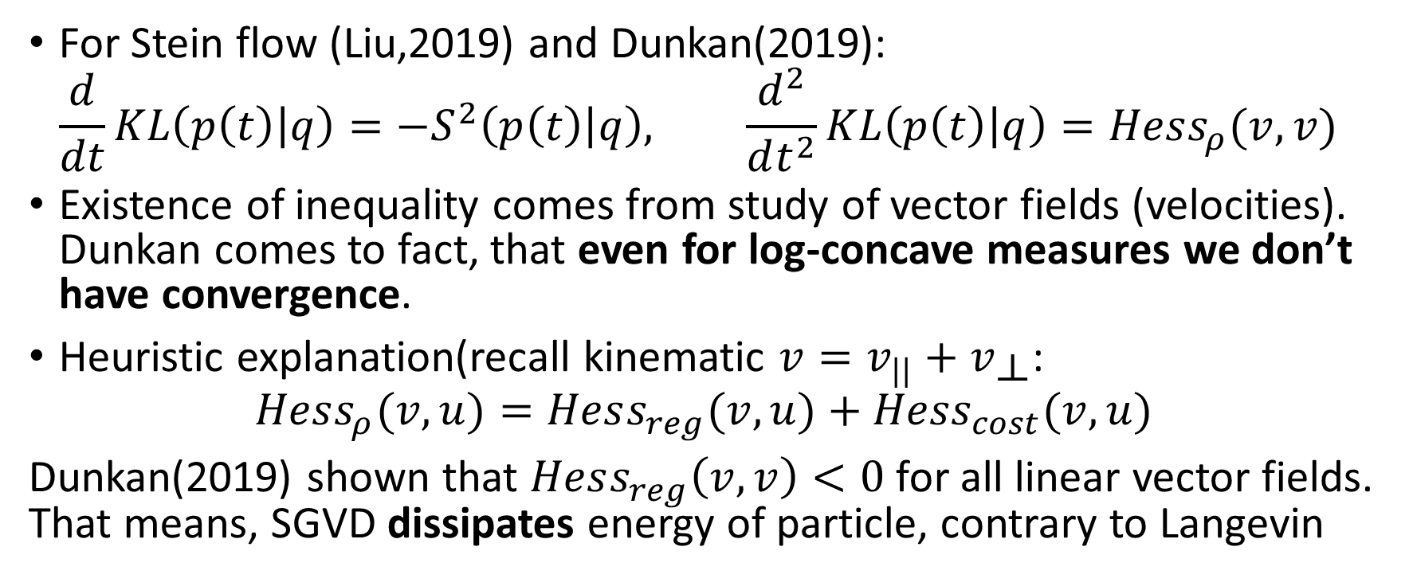
Log-Sobolev for Stein Discrepancy?
For Stein flow (Liu,2019) and Dunkan(2019):
$$\frac{d}{dt}KL\left(p\left(t\right) | q\right)=−S^{2}\left(p\left(t\right) | q\right), \frac{d^{2}}{dt^{2}}KL\left(p\left(t\right) | q\right)=Hess_{ρ}(v,v)$$
Existence of inequality comes from study of vector fields (velocities). Dunkan comes to fact, that even for log-concave measures we don’t have convergence.
Heuristic explanation(recall kinematic $v=v_{||}+v_{\text{⟂}}$:
$$Hess_{ρ}(v,u)=Hess_{reg}(v,u)+{Hess}_{cost}(v,u)$$
Dunkan(2019) shown that $Hess_{reg}\left(v,v\right)<0$ for all linear vector fields. That means, SGVD dissipates energy of particle, contrary to Langevin

Slide 11
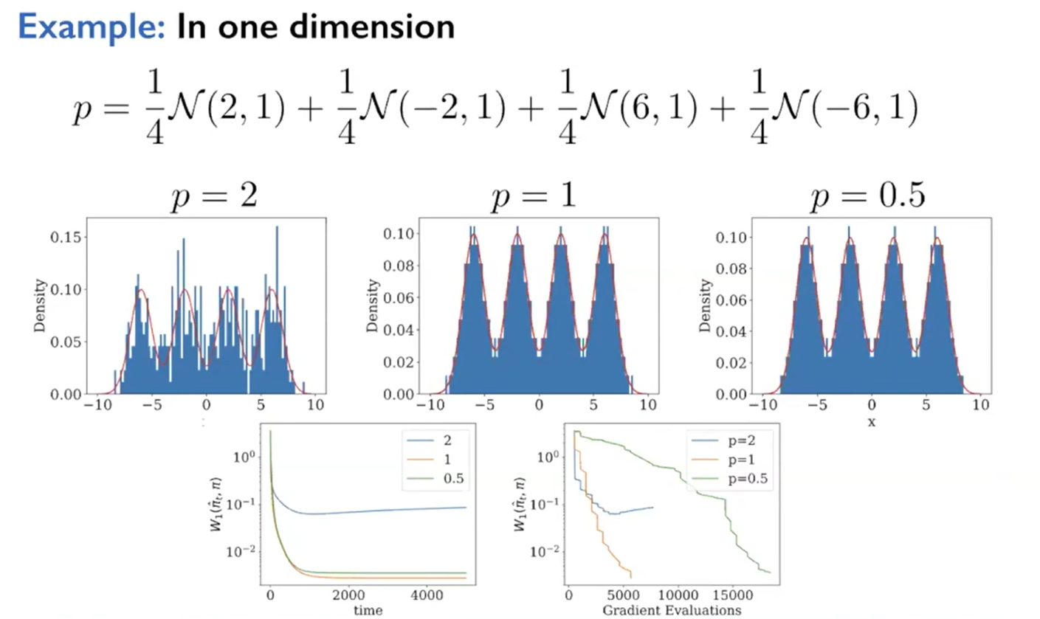

Mattern kernel $k(x,y) = exp⁡(−\frac{{\left|x−y\right|}^{σ}}{σ^{p}})$

Slide 12
Adjourn
For arbitrary kernel doen’t have convergence guarantees even in Mean field and infinitesimal settings
So we need to pay attention to selection of kernel and selection of prior, which can reach
Advised approach seems reductionist in sense of optimal transport. Juveniles researches works on more grounded approaches as projection, natural gradient and functional
Rewind author video: https://youtu.be/2tiu3HDJjE4?t=2037

Slide 13
Question

Slide 14
Recall, you mentioned problem with curse of dimension. Elaborate on it.
Kernel methods is known to work bad in high dimensional settings, due to tractability and distance concentration. If your weights are standard normally distributed, with increase of dimension distance between points will become N(1,O(1/d)). So kernel lose their sensitivity.
But if output of net is low dimensional (scoring), we can imagine particle to be a function instead of weights of net.See Function space particle optimization for bayesian neural networks (Wang, 2019) for elaboration on idea
Article link https://arxiv.org/pdf/1902.09754

Slide 15
Can I use this sampling approach to llm and stable diffusion models?
Definitely for SD. Research community knows it as ParVIs methods. Check Prolific and Stein Dreamer articles.
To my best knowledge kernelized sampling methods are unknown for transformer llm. Yet you can use stein distance for alignment (but why?)
Prolific https://arxiv.org/abs/2305.16213
Stein https://arxiv.org/abs/2401.00604

Slide 16
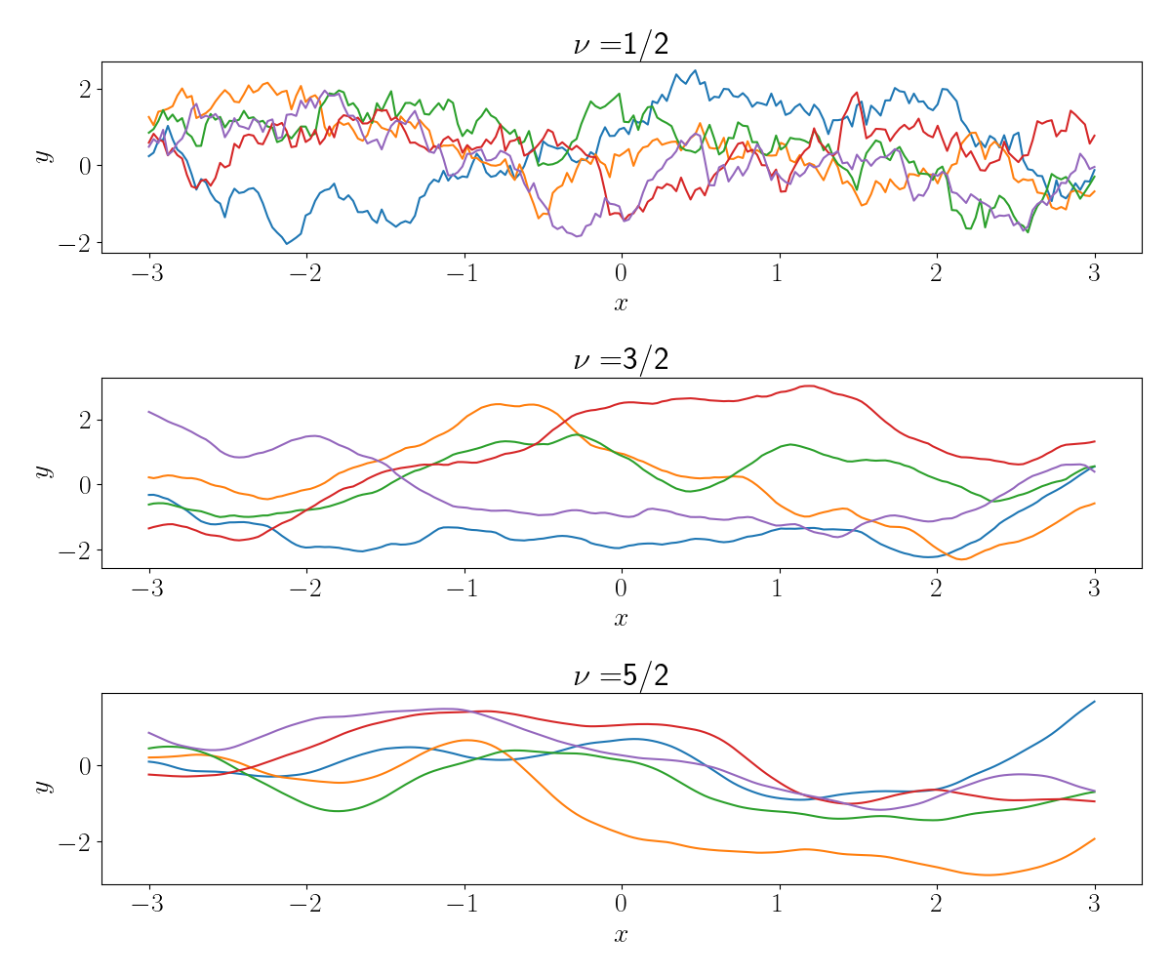
https://andrewcharlesjones.github.io/journal/matern-kernels.html

